Slide 1
Programming Building Blocks
Data-processing Instructions
Conditional Execution
Branches
High-level Constructs:
  if/else statements
  for loops
  while loops
  arrays
  function calls

Slide 2
if Statement
C Code
if (i == j)
f = g + h;
f = f – i;

Slide 3
if Statement
C Code
if (i == j)
f = g + h;
f = f – i;
ARM Assembly Code
;R0=f, R1=g, R2=h, R3=i, R4=j
CMP R3, R4 ; set flags with R3-R4
BNE L1 ; if i!=j, skip if block
ADD R0, R1, R2 ; f = g + h
L1
SUB R0, R0, R2 ; f = f - i

Slide 4
if Statement
C Code
if (i == j)
f = g + h;
f = f – i;
ARM Assembly Code
;R0=f, R1=g, R2=h, R3=i, R4=j
CMP R3, R4 ; set flags with R3-R4
BNE L1 ; if i!=j, skip if block
ADD R0, R1, R2 ; f = g + h
L1
SUB R0, R0, R2 ; f = f - i
Assembly tests opposite case (i != j) of high-level code (i == j)

Slide 5
if Statement: Alternate Code
C Code
if (i == j)
f = g + h;
f = f – i;
ARM Assembly Code
;R0=f, R1=g, R2=h, R3=i, R4=j
CMP R3, R4 ; set flags with R3-R4
ADDEQ R0, R1, R2 ; if (i==j) f = g + h
SUB R0, R0, R2 ; f = f - i

Slide 6
if Statement: Alternate Code
Alternate Assembly Code
;R0=f, R1=g, R2=h, R3=i, R4=j
CMP R3, R4 ; set flags with R3-R4
ADDEQ R0, R1, R2 ; if (i==j) f = g + h
SUB R0, R0, R2 ; f = f - i
Original
CMP R3, R4
BNE L1
ADD R0, R1, R2
L1
SUB R0, R0, R2

Slide 7
if Statement: Alternate Code
Alternate Assembly Code
;R0=f, R1=g, R2=h, R3=i, R4=j
CMP R3, R4 ; set flags with R3-R4
ADDEQ R0, R1, R2 ; if (i==j) f = g + h
SUB R0, R0, R2 ; f = f - i
Original
CMP R3, R4
BNE L1
ADD R0, R1, R2
L1
SUB R0, R0, R2
Useful for short conditional blocks of code

Slide 8
if/else Statement
C Code
if (i == j)
f = g + h;
else
f = f – i;
ARM Assembly Code

Slide 9
if/else Statement
C Code
if (i == j)
f = g + h;
else
f = f – i;
ARM Assembly Code
;R0=f, R1=g, R2=h, R3=i, R4=j
CMP R3, R4 ; set flags with R3-R4
BNE L1 ; if i!=j, skip if block
ADD R0, R1, R2 ; f = g + h
B L2 ; branch past else block
L1
SUB R0, R0, R2 ; f = f – i
L2

Slide 10
if/else Statement: Alternate Code
C Code
if (i == j)
f = g + h;
else
f = f – i;
ARM Assembly Code
;R0=f, R1=g, R2=h, R3=i, R4=j
CMP R3, R4 ; set flags with R3-R4
ADDEQ R0, R1, R2 ; if (i==j) f = g + h
SUBNE R0, R0, R2 ; else f = f - i

Slide 11
if/else Statement: Alternate Code
Original
CMP R3, R4
BNE L1
ADD R0, R1, R2
B L2
L1
SUB R0, R0, R2
L2
Alternate Assembly Code
;R0=f, R1=g, R2=h, R3=i, R4=j
CMP R3, R4 ; set flags with R3-R4
ADDEQ R0, R1, R2 ; if (i==j) f = g + h
SUBNE R0, R0, R2 ; else f = f - i

Slide 12
while Loops
C Code
// determines the power
// of x such that 2^{x} = 128
int pow = 1;
int x = 0;
while (pow != 128) {
pow = pow * 2;
x = x + 1;
}
ARM Assembly Code

Slide 13
while Loops
C Code
// determines the power
// of x such that 2^{x} = 128
int pow = 1;
int x = 0;
while (pow != 128) {
pow = pow * 2;
x = x + 1;
}
ARM Assembly Code
; R0 = pow, R1 = x
MOV R0, #1 ; pow = 1
MOV R1, #0 ; x = 0
WHILE
CMP R0, #128 ; R0-128
BEQ DONE ; if (pow==128) ; exit loop
LSL R0, R0, #1 ; pow=pow*2
ADD R1, R1, #1 ; x=x+1
B WHILE ; repeat loop
DONE

Slide 14
while Loops
C Code
// determines the power
// of x such that 2^{x} = 128
int pow = 1;
int x = 0;
while (pow != 128) {
pow = pow * 2;
x = x + 1;
}
ARM Assembly Code
; R0 = pow, R1 = x
MOV R0, #1 ; pow = 1
MOV R1, #0 ; x = 0
WHILE
CMP R0, #128 ; R0-128
BEQ DONE ; if (pow==128) ; exit loop
LSL R0, R0, #1 ; pow=pow*2
ADD R1, R1, #1 ; x=x+1
B WHILE ; repeat loop
DONE
Assembly tests for the opposite case (pow == 128) of the C code (pow != 128).

Slide 15
for Loops
for (initialization; condition; loop operation)
statement
initialization: executes before the loop begins
condition: is tested at the beginning of each iteration
loop operation: executes at the end of each iteration
statement: executes each time the condition is met

Slide 16
for Loops
C Code
// adds numbers from 1-9
int sum = 0;
int i;
for (i=1; i!=10; i=i+1)
sum = sum + i;
ARM Assembly Code

Slide 17
for Loops
C Code
// adds numbers from 1-9
int sum = 0
for (i=1; i!=10; i=i+1)
sum = sum + i;
ARM Assembly Code
; R0 = i, R1 = sum
MOV R0, #1 ; i = 1
MOV R1, #0 ; sum = 0
FOR
CMP R0, #10 ; R0-10
BEQ DONE ; if (i==10) ; exit loop
ADD R1, R1, R0 ; sum=sum + i
ADD R0, R0, #1 ; i = i + 1
B FOR ; repeat loop
DONE

Slide 18
for Loops: Decremented Loops
In ARM, decremented loop variables are more efficient

Slide 19
for Loops: Decremented Loops
In ARM, decremented loop variables are more efficient
C Code
// adds numbers from 1-9
int sum = 0
for (i=9; i!=0; i=i-1)
sum = sum + i;
ARM Assembly Code
; R0 = i, R1 = sum
MOV R0, #9 ; i = 9
MOV R1, #0 ; sum = 0
FOR
ADD R1, R1, R0 ; sum=sum + i
SUBS R0, R0, #1 ; i = i – 1
; and set flags
BNE FOR ; if (i!=0) ; repeat loop

Slide 20
for Loops: Decremented Loops
In ARM, decremented loop variables are more efficient
C Code
// adds numbers from 1-9
int sum = 0
for (i=9; i!=0; i=i-1)
sum = sum + i;
ARM Assembly Code
; R0 = i, R1 = sum
MOV R0, #9 ; i = 9
MOV R1, #0 ; sum = 0
FOR
ADD R1, R1, R0 ; sum=sum + i
SUBS R0, R0, #1 ; i = i – 1
; and set flags
BNE FOR ; if (i!=0) ; repeat loop
Saves 2 instructions per iteration:
Decrement loop variable & compare: SUBS R0, R0, #1
Only 1 branch – instead of 2

Slide 21
Programming Building Blocks
Data-processing Instructions
Conditional Execution
Branches
High-level Constructs:
  if/else statements
  for loops
  while loops
  arrays
  function calls

Slide 22
Arrays
Access large amounts of similar data
  Index: access to each element
  Size: number of elements

Slide 23
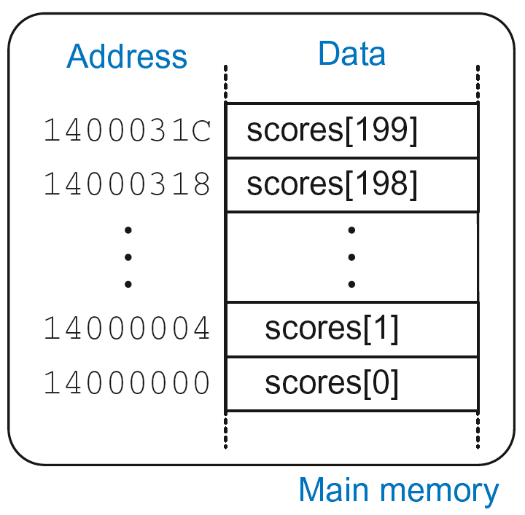
Arrays
200-element array
  Base address = 0x14000000 (address of first element, scores[0])
  Array elements accessed relative to base address

Slide 24
Accessing Arrays
C Code
int array[200];
array[0] = array[0] * 8;
array[1] = array[1] * 8;
ARM Assembly Code
; R0 = array base address

Slide 25
Accessing Arrays
C Code
int array[5];
array[0] = array[0] * 8;
array[1] = array[1] * 8;
ARM Assembly Code
; R0 = array base address
MOV R0, #0x60000000 ; R0 = 0x60000000
LDR R1, [R0] ; R1 = array[0]
LSL R1, R1, 3 ; R1 = R1 << 3 = R1*8
STR R1, [R0] ; array[0] = R1
LDR R1, [R0, #4] ; R1 = array[1]
LSL R1, R1, 3 ; R1 = R1 << 3 = R1*8
STR R1, [R0, #4] ; array[1] = R1

Slide 26
Arrays using for Loops
C Code
int array[200];
int i;
for (i=199; i >= 0; i = i - 1)
array[i] = array[i] * 8;
ARM Assembly Code
; R0 = array base address, R1 = i

Slide 27
Arrays using for Loops
C Code
int array[200];
int i;
for (i=199; i >= 0; i = i - 1)
array[i] = array[i] * 8;
ARM Assembly Code
; R0 = array base address, R1 = i
MOV R0, 0x60000000
MOV R1, #199
FOR
LDR R2, [R0, R1, LSL #2] ; R2 = array(i)
LSL R2, R2, #3 ; R2 = R2<<3 = R3*8
STR R2, [R0, R1, LSL #2] ; array(i) = R2
SUBS R1, R1, #1 ; i = i – 1
; and set flags
BPL FOR ; if (i>=0) repeat loop

Slide 28
ASCII Code
American Standard Code for Information Interchange
Each text character has unique byte value
  For example, S = 0x53, a = 0x61, A = 0x41
  Lower-case and upper-case differ by 0x20 (32)

Slide 29
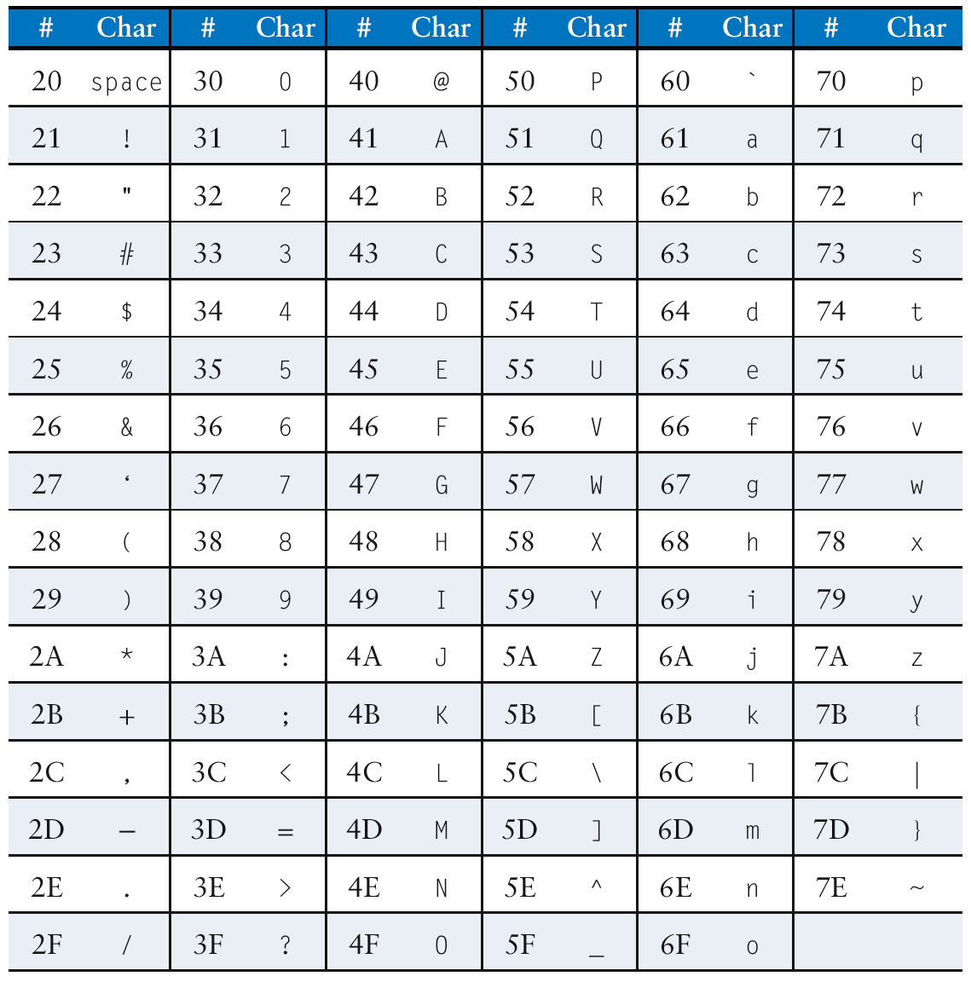
Cast of Characters

Slide 30
Programming Building Blocks
Data-processing Instructions
Conditional Execution
Branches
High-level Constructs:
  if/else statements
  for loops
  while loops
  arrays
  function calls

Slide 31
Function Calls
Caller: calling function (in this case, main)
Callee: called function (in this case, sum)
C Code
void main()
{
int y;
y = sum(42, 7);
...
}
int sum(int a, int b)
{
return (a + b);
}

Slide 32
Function Conventions
Caller:
  passes arguments to callee
  jumps to callee

Slide 33
Function Conventions
Caller:
  passes arguments to callee
  jumps to callee
Callee:
  performs the function
  returns result to caller
  returns to point of call
  must not overwrite registers or memory needed by caller

Slide 34
ARM Function Conventions
Call Function: branch and link
BL
Return from function: move the link register to PC: MOV PC, LR
Arguments: R0-R3
Return value: R0

Slide 35
Function Calls
C Code
int main() {
simple();
a = b + c;
}
void simple() {
return;
}
ARM Assembly Code
0x00000200 MAIN BL SIMPLE
0x00000204 ADD R4, R5, R6
...
0x00401020 SIMPLE MOV PC, LR
void means that simple doesn’t return a value

Slide 36
Function Calls
C Code
int main() {
simple();
a = b + c;
}
void simple() {
return;
}
ARM Assembly Code
0x00000200 MAIN BL SIMPLE
0x00000204 ADD R4, R5, R6
...
0x00401020 SIMPLE MOV PC, LR
BL branches to SIMPLE
LR = PC + 4 = 0x00000204
MOV PC, LR makes PC = LR
(the next instruction executed is at 0x00000204)

Slide 37
Input Arguments and Return Value
ARM conventions:
Argument values: R0 - R3
Return value: R0

Slide 38
Input Arguments and Return Value
C Code
int main()
{
int y;
...
y = diffofsums(2, 3, 4, 5); // 4 arguments
...
}
int diffofsums(int f, int g, int h, int i)
{
int result;
result = (f + g) - (h + i);
return result; // return value
}

Slide 39
Input Arguments and Return Value
ARM Assembly Code
; R4 = y
MAIN
...
MOV R0, #2 ; argument 0 = 2
MOV R1, #3 ; argument 1 = 3
MOV R2, #4 ; argument 2 = 4
MOV R3, #5 ; argument 3 = 5
BL DIFFOFSUMS ; call function
MOV R4, R0 ; y = returned value
...
; R4 = result
DIFFOFSUMS
ADD R8, R0, R1 ; R8 = f + g
ADD R9, R2, R3 ; R9 = h + i
SUB R4, R8, R9 ; result = (f + g) - (h + i)
MOV R0, R4 ; put return value in R0
MOV PC, LR ; return to caller

Slide 40
Input Arguments and Return Value
ARM Assembly Code
; R4 = result
DIFFOFSUMS
ADD R8, R0, R1 ; R8 = f + g
ADD R9, R2, R3 ; R9 = h + i
SUB R4, R8, R9 ; result = (f + g) - (h + i)
MOV R0, R4 ; put return value in R0
MOV PC, LR ; return to caller
diffofsums overwrote 3 registers: R4, R8, R9
diffofsums can use stack to temporarily store registers

Slide 41

The Stack
Memory used to temporarily save variables
Like stack of dishes, last-in-first-out (LIFO) queue
Expands: uses more memory when more space needed
Contracts: uses less memory when the space no longer needed

Slide 42
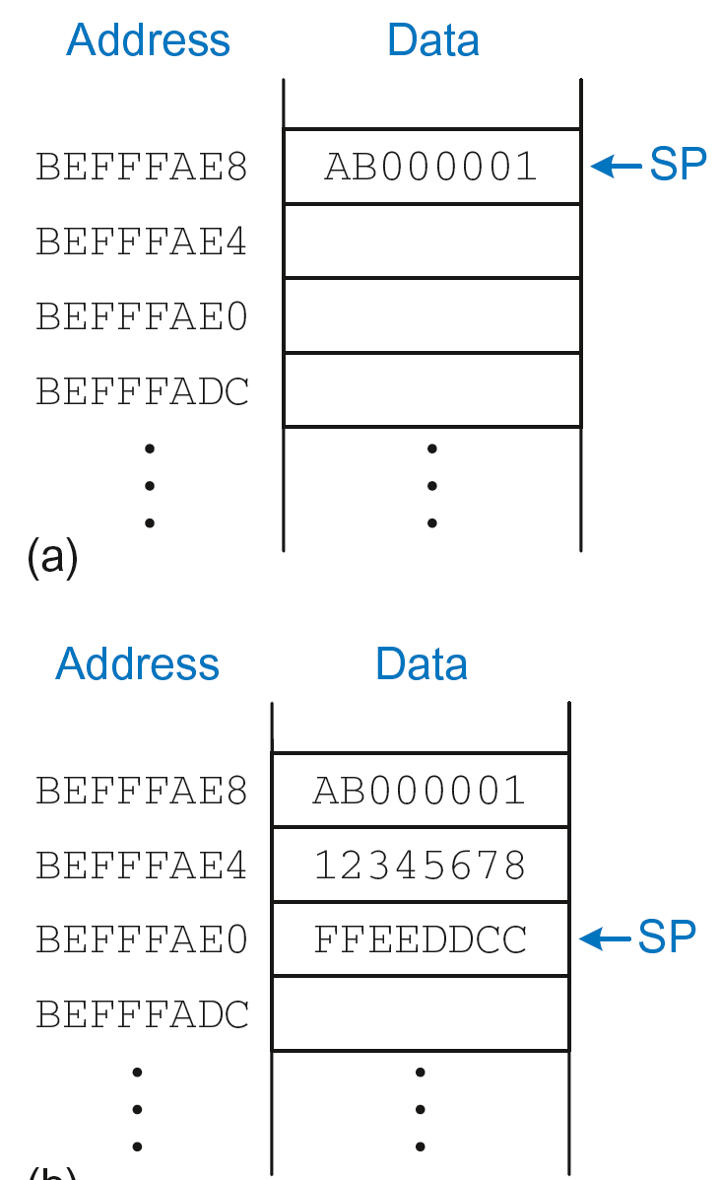
The Stack
Grows down (from higher to lower memory addresses)
Stack pointer: SP points to top of the stack
Stack expands by 2 words

Slide 43
How Functions use the Stack
Called functions must have no unintended side effects
But diffofsums overwrites 3 registers: R4, R8, R9
ARM Assembly Code
; R4 = result
DIFFOFSUMS
ADD R8, R0, R1 ; R8 = f + g
ADD R9, R2, R3 ; R9 = h + i
SUB R4, R8, R9 ; result = (f + g) - (h + i)
MOV R0, R4 ; put return value in R0
MOV PC, LR ; return to caller

Slide 44
Storing Register Values on the Stack
ARM Assembly Code
; R2 = result
DIFFOFSUMS
SUB SP, SP, #12 ; make space on stack for 3 registers
STR R4, [SP, #8] ; save R4 on stack
STR R8, [SP, #4] ; save R8 on stack
STR R9, [SP] ; save R9 on stack
ADD R8, R0, R1 ; R8 = f + g
ADD R9, R2, R3 ; R9 = h + i
SUB R4, R8, R9 ; result = (f + g) - (h + i)
MOV R0, R4 ; put return value in R0
LDR R9, [SP] ; restore R9 from stack
LDR R8, [SP, #4] ; restore R8 from stack
LDR R4, [SP, #8] ; restore R4 from stack
ADD SP, SP, #12 ; deallocate stack space
MOV PC, LR ; return to caller

Slide 45
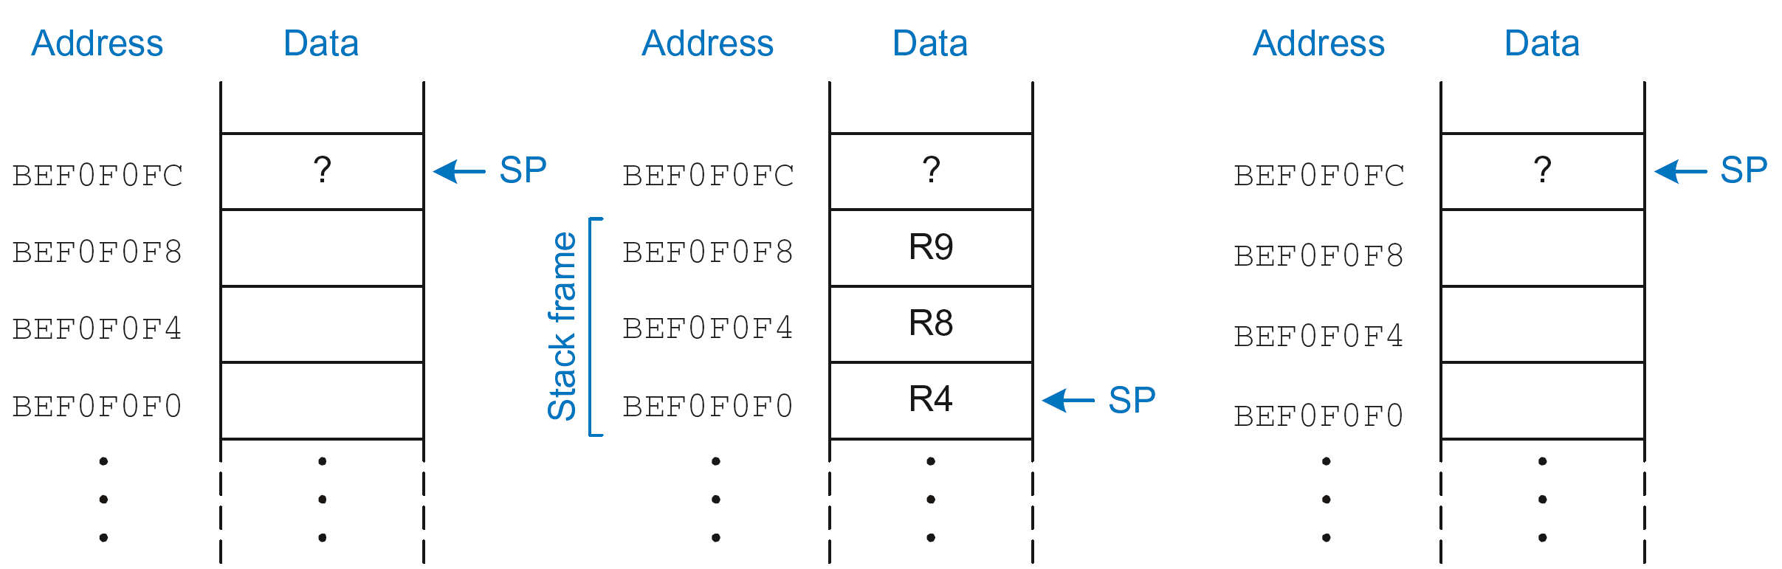
The Stack during diffofsums Call
Before call
During call
After call

Slide 46
Registers
Preserved Callee-Saved | Nonpreserved Caller-Saved
R4-R11 | R12
R14 (LR) | R0-R3
R13 (SP) | CPSR
stack above SP | stack below SP

Slide 47
Storing Saved Registers only on Stack
ARM Assembly Code
; R2 = result
DIFFOFSUMS
STR R4, [SP, #-4]! ; save R4 on stack
ADD R8, R0, R1 ; R8 = f + g
ADD R9, R2, R3 ; R9 = h + i
SUB R4, R8, R9 ; result = (f + g) - (h + i)
MOV R0, R4 ; put return value in R0
LDR R4, [SP], #4 ; restore R4 from stack
MOV PC, LR ; return to caller

Slide 48
Storing Saved Registers only on Stack
ARM Assembly Code
; R2 = result
DIFFOFSUMS
STR R4, [SP, #-4]! ; save R4 on stack
ADD R8, R0, R1 ; R8 = f + g
ADD R9, R2, R3 ; R9 = h + i
SUB R4, R8, R9 ; result = (f + g) - (h + i)
MOV R0, R4 ; put return value in R0
LDR R4, [SP], #4 ; restore R4 from stack
MOV PC, LR ; return to caller
Notice code optimization for expanding/contracting stack

Slide 49
Nonleaf Function
ARM Assembly Code
STR LR, [SP, #-4]! ; store LR on stack
BL PROC2 ; call another function
...
LDR LR, [SP], #4 ; restore LR from stack
MOV PC, LR ; return to caller

Slide 50
Nonleaf Function Example
C Code
int f1(int a, int b) {
int i, x;
x = (a + b)*(a − b);
for (i=0; i<a; i++)
x = x + f2(b+i);
return x;
}
int f2(int p) {
int r;
r = p + 5;
return r + p;
}

Slide 51
Nonleaf Function Example
C Code
int f1(int a, int b) {
int i, x;
x = (a + b)*(a − b);
for (i=0; i<a; i++)
x = x + f2(b+i);
return x;
}
int f2(int p) {
int r;
r = p + 5;
return r + p;
}
ARM Assembly Code
; R0=a, R1=b, R4=i, R5=x
F1
PUSH {R4, R5, LR}
ADD R5, R0, R1
SUB R12, R0, R1
MUL R5, R5, R12
MOV R4, #0
FOR
CMP R4, R0
BGE RETURN
PUSH {R0, R1}
ADD R0, R1, R4
BL F2
ADD R5, R5, R0
POP {R0, R1}
ADD R4, R4, #1
B FOR
RETURN
MOV R0, R5
POP {R4, R5, LR}
MOV PC, LR
; R0=p, R4=r
F2
PUSH {R4}
ADD R4, R0, 5
ADD R0, R4, R0
POP {R4}
MOV PC, LR

Slide 52
Nonleaf Function Example
ARM Assembly Code
; R0=a, R1=b, R4=i, R5=x
F1
PUSH {R4, R5, LR} ; save regs
ADD R5, R0, R1 ; x = (a+b)
SUB R12, R0, R1 ; temp = (a-b)
MUL R5, R5, R12 ; x = x*temp
MOV R4, #0 ; i = 0
FOR
CMP R4, R0 ; i < a?
BGE RETURN ; no: exit loop
PUSH {R0, R1} ; save regs
ADD R0, R1, R4 ; arg is b+i
BL F2 ; call f2(b+i)
ADD R5, R5, R0 ; x = x+f2(b+i)
POP {R0, R1} ; restore regs
ADD R4, R4, #1 ; i++
B FOR ; repeat loop
RETURN
MOV R0, R5 ; return x
POP {R4, R5, LR} ; restore regs
MOV PC, LR ; return
; R0=p, R4=r
F2
PUSH {R4} ; save regs
ADD R4, R0, 5 ; r = p+5
ADD R0, R4, R0 ; return r+p
POP {R4} ; restore regs
MOV PC, LR ; return

Slide 53
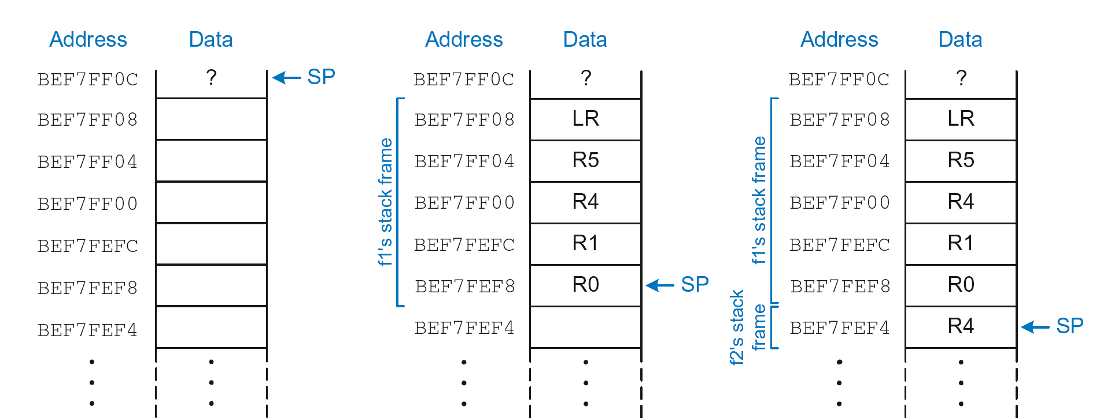
Stack during Nonleaf Function
At beginning of f1
Just before calling f2
After calling f2

Slide 54
Recursive Function Call
C Code
int factorial(int n) {
if (n <= 1)
return 1;
else
return (n * factorial(n-1));
}

Slide 55
Recursive Function Call
ARM Assembly Code
0x94 FACTORIAL STR R0, [SP, #-4]! ;store R0 on stack
0x98 STR LR, [SP, #-4]! ;store LR on stack
0x9C CMP R0, #2 ;set flags with R0-2
0xA0 BHS ELSE ;if (r0>=2) branch to else
0xA4 MOV R0, #1 ; otherwise return 1
0xA8 ADD SP, SP, #8 ; restore SP 1
0xAC MOV PC, LR ; return
0xB0 ELSE SUB R0, R0, #1 ; n = n - 1
0xB4 BL FACTORIAL ; recursive call
0xB8 LDR LR, [SP], #4 ; restore LR
0xBC LDR R1, [SP], #4 ; restore R0 (n) into R1
0xC0 MUL R0, R1, R0 ; R0 = n*factorial(n-1)
0xC4 MOV PC, LR ; return

Slide 56
Recursive Function Call
C Code
int factorial(int n) {
if (n <= 1)
return 1;
else
return (n * factorial(n-1));
}
ARM Assembly Code
0x94 FACTORIAL STR R0, [SP, #-4]!
0x98 STR LR, [SP, #-4]!
0x9C CMP R0, #2
0xA0 BHS ELSE
0xA4 MOV R0, #1
0xA8 ADD SP, SP, #8
0xAC MOV PC, LR
0xB0 ELSE SUB R0, R0, #1
0xB4 BL FACTORIAL
0xB8 LDR LR, [SP], #4
0xBC LDR R1, [SP], #4
0xC0 MUL R0, R1, R0
0xC4 MOV PC, LR

Slide 57
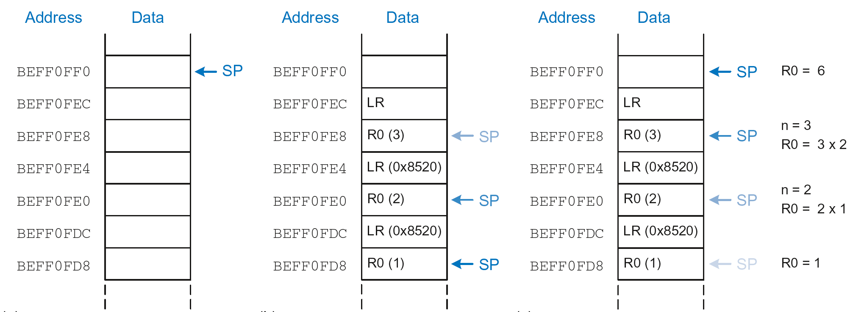
Stack during Recursive Call
Before call
During call
After call

Slide 58
Function Call Summary
Caller
  Puts arguments in R0-R3
  Saves any needed registers (LR, maybe R0-R3, R8-R12)
  Calls function: BL CALLEE
  Restores registers
  Looks for result in R0
Callee
  Saves registers that might be disturbed (R4-R7)
  Performs function
  Puts result in R0
  Restores registers
  Returns: MOV PC, LR

